Slide 1
Security
Lecturer: Ngo Huy Bien
Software Engineering Department
Faculty of Information Technology
VNUHCM - University of Science
Ho Chi Minh City, Vietnam
nhbien@fit.hcmus.edu.vn

Slide 2

Objectives

Slide 3

Contents

Slide 4

References
Prabath Siriwardena and Nuwan Dias (2020). Microservices Security in Action. Manning Publications.

Slide 5
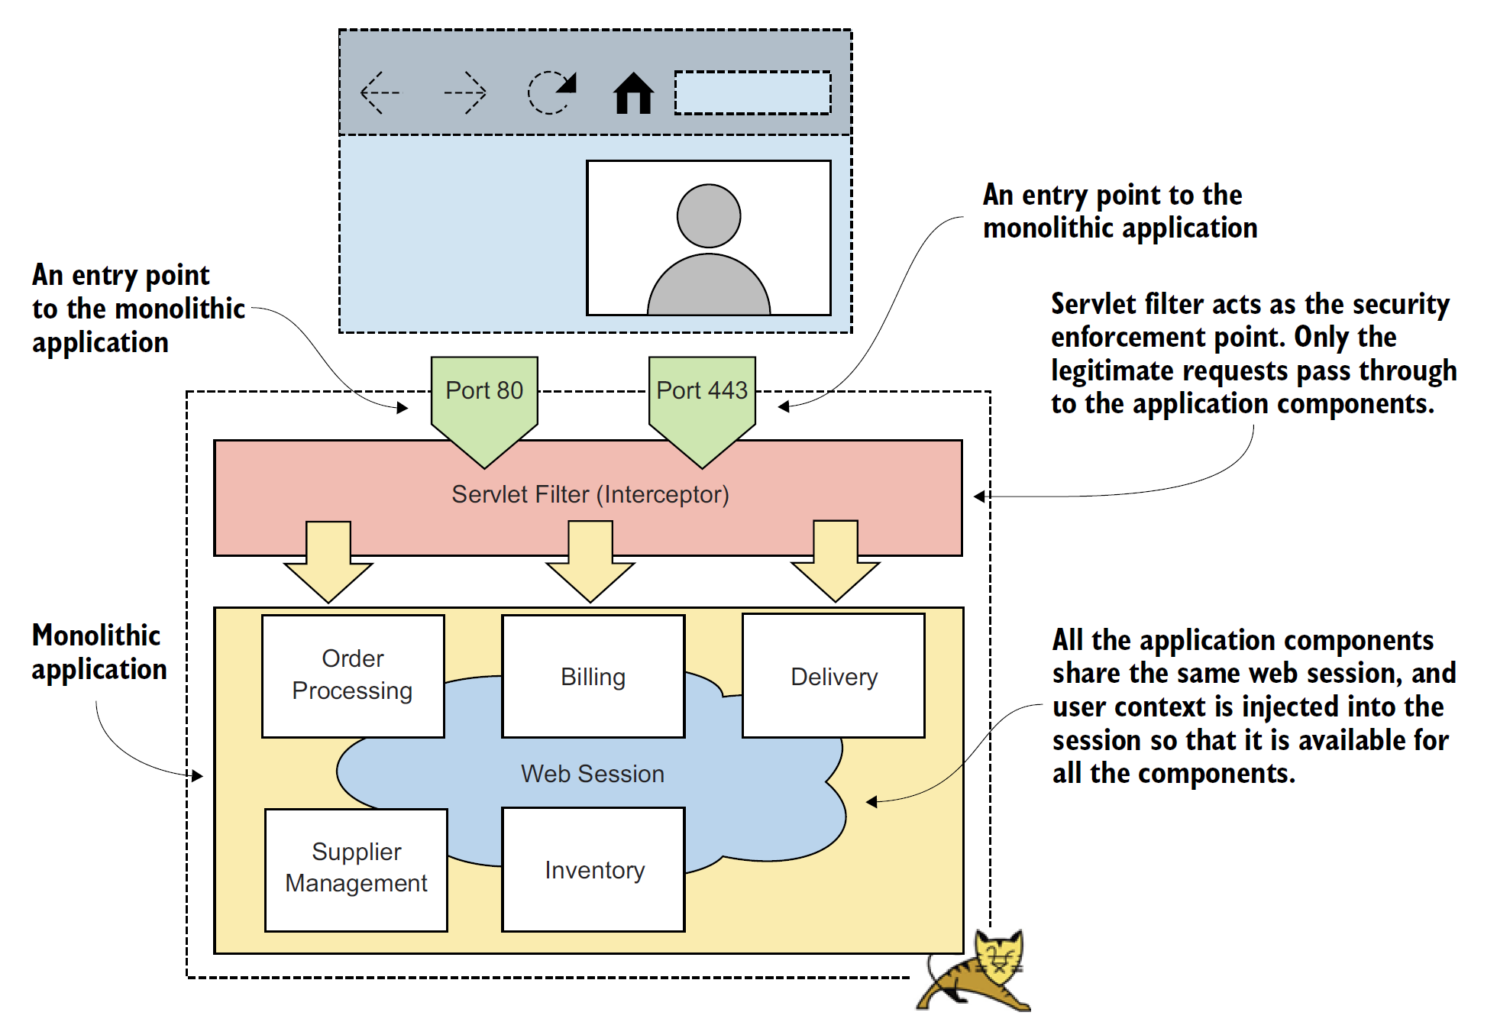
Monolithic Application

Slide 6
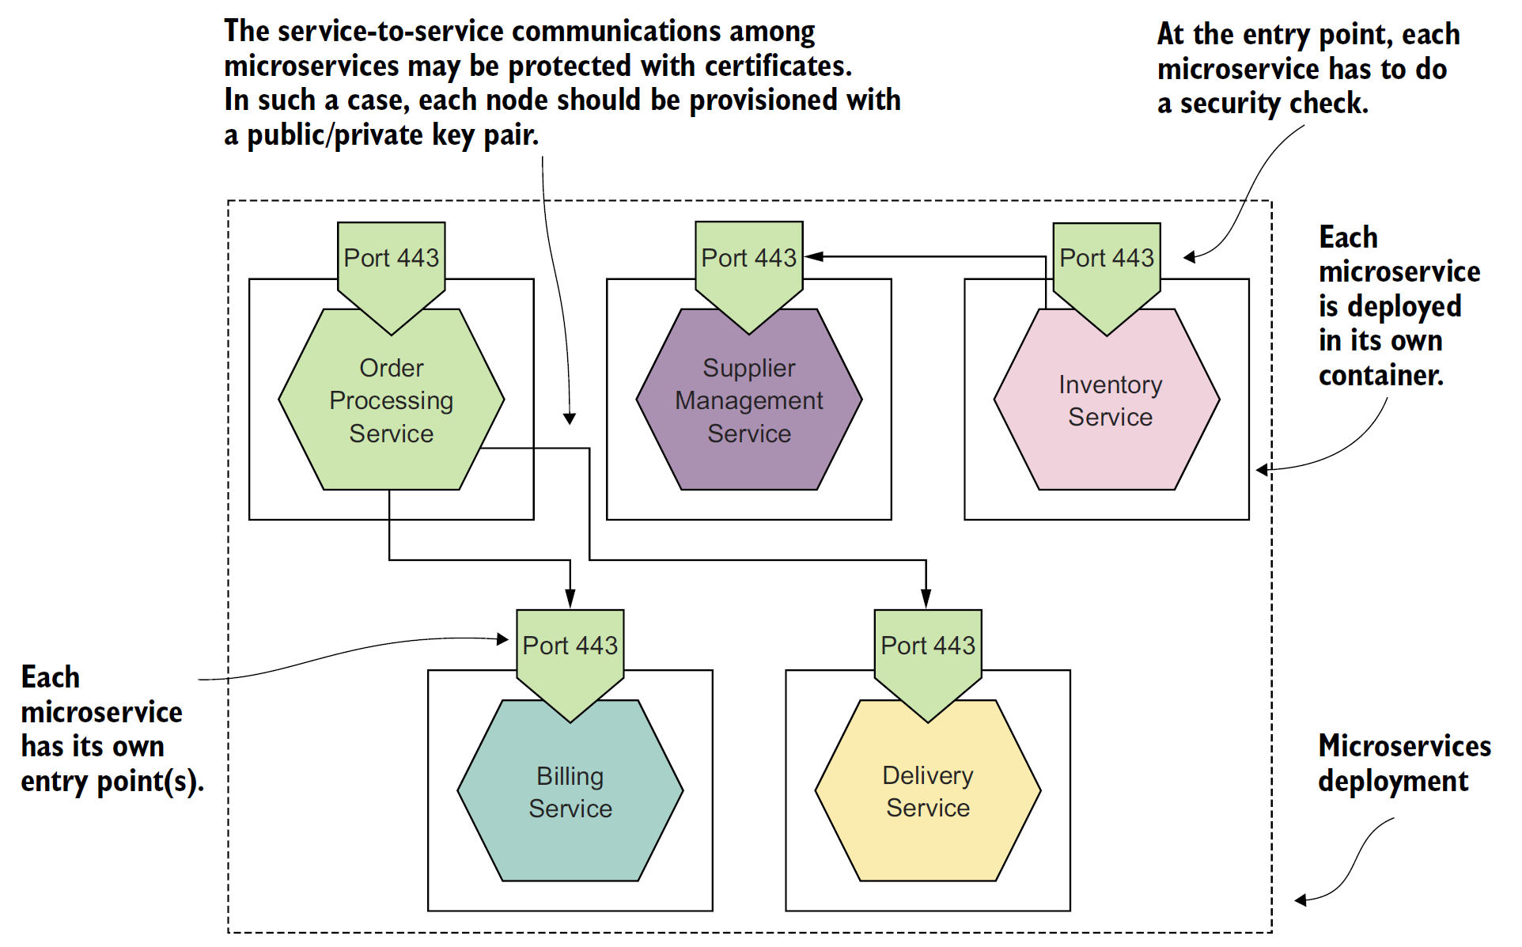
Microservices
As opposed to a monolithic application with few entry points, a microservices-based application has many entry points that all must be secured.

Slide 7
Security Fundamentals
Authentication protects your system against spoofing
Integrity protects your system from data tampering
Nonrepudiation: Do it once, and you own it forever
Confidentiality protects your systems from unintended information disclosure
Availability: Keep the system running, no matter what
Authorization: Nothing more than you’re supposed to do

Slide 8

Thank You & See You Again

